Slide 1


KONGU ENGINEERING COLLEGE
PERUNDURAI ERODE-638060
DEPARMENT OF COMPUTER TECHNOLOGY – PG
M.Sc SOFTWARE SYSTEMS
22ISF05 – DEVOPS
DOCKER NETWORKING WITH ISOLATED CONTAINER
GUIDED BY:
T.E. Ramya Assistant Professor , Department of CT-PG, Kongu Engineering College,
Perundurai.
PRESENTED BY :
BALAJI B R (22ISR006)
Department of CT-PG, Kongu Engineering College,
Perundurai

Slide 2
PROBLEM STATEMENT
In modern software development, containerization offers a powerful way to deploy applications efficiently. However, managing network communication between containers while ensuring isolation, security, and controlled access remains a critical challenge. Unrestricted communication between all containers can lead to security risks and unintended data exposure.

Slide 3
SOLUTION
Use Docker custom networks (e.g., bridge networks) to isolate containers and control inter-container communication.
Assign services to specific networks to ensure that only intended containers can communicate with each other.
Validate isolation by testing communication between containers within the same network and blocking access between containers on different networks.
Monitor network traffic and container interactions using Docker networking commands and logs to ensure secure and predictable behavior.

Slide 4
Existing System & Disadvantages
Existing System:
Containers deployed on Docker’s default bridge network.
Disadvantages:
Lack of isolation
Security risks
Poor scalability
Limited control

Slide 5
Proposed System & Advantages
Proposed System:
Use docker network create for isolated networks.
Attach containers only to required networks.
Use Docker Compose for orchestration.
Advantages:
Enhanced security
Modularity
Scalability
Easier debugging

Slide 6
Technology Stack
Operating System:
Windows 10/11 with WSL 2 or Ubuntu 20.04+
Platform:
Docker Engine
Languages:
Python (for appA.py, appB.py)
Tools:
Docker CLI, Docker Compose, VS Code

Slide 7
System Workflow
1. Install and verify Docker.
2. Create custom networks: net1, net2.
3. Build and deploy containers:
- ContainerA -> net1
- ContainerB -> net2
- Controller -> net1 & net2
4. Use `ping`/`curl` to test communication

Slide 8
Module Description
Docker Installation Module
Network Creation Module
Container Deployment Module
Isolation Testing Module
Controlled Communication Module

Slide 9
Conclusion & Future Enhancements
Conclusion:
Docker enables secure container isolation.
Allows controlled communication.
Future Enhancements:
Dynamic DNS discovery
Monitoring tools
Multi-host networking

Slide 10
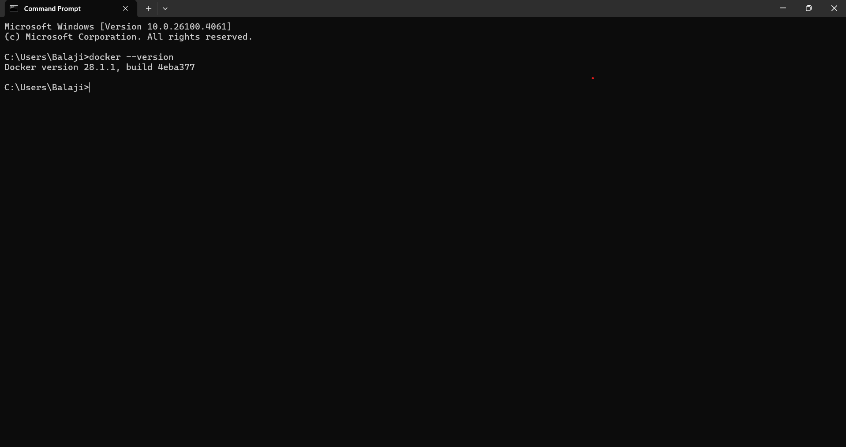
Screenshots A2.1 – Docker Installation Verification

Slide 11
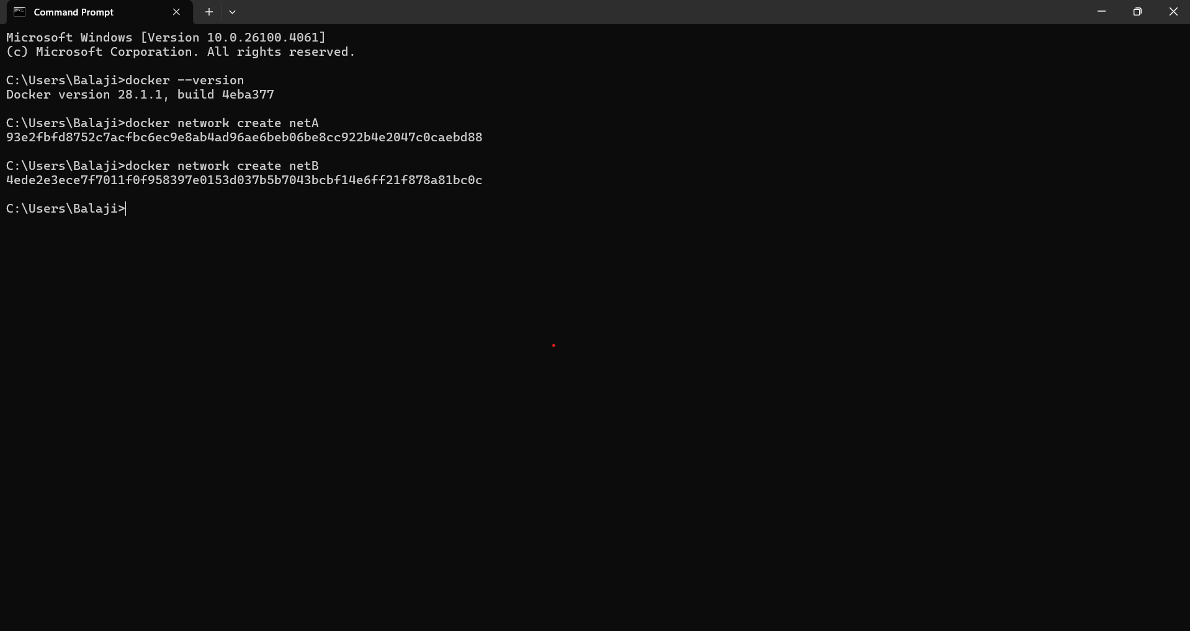
Figure A2.2 – Creating Isolated Docker Networks

Slide 12
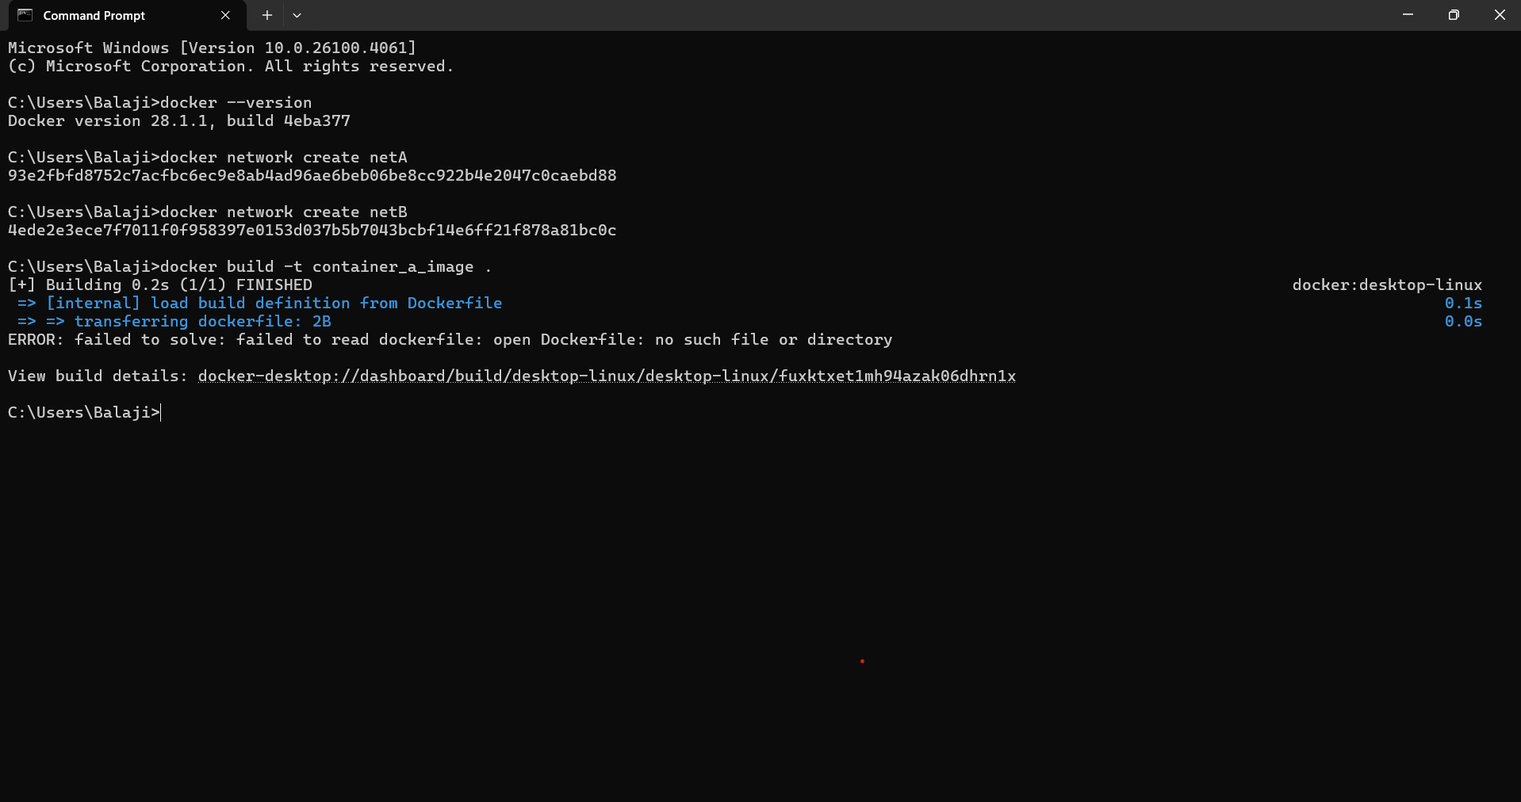
Figure A2.3 – Building Docker Images for Containers

Slide 13
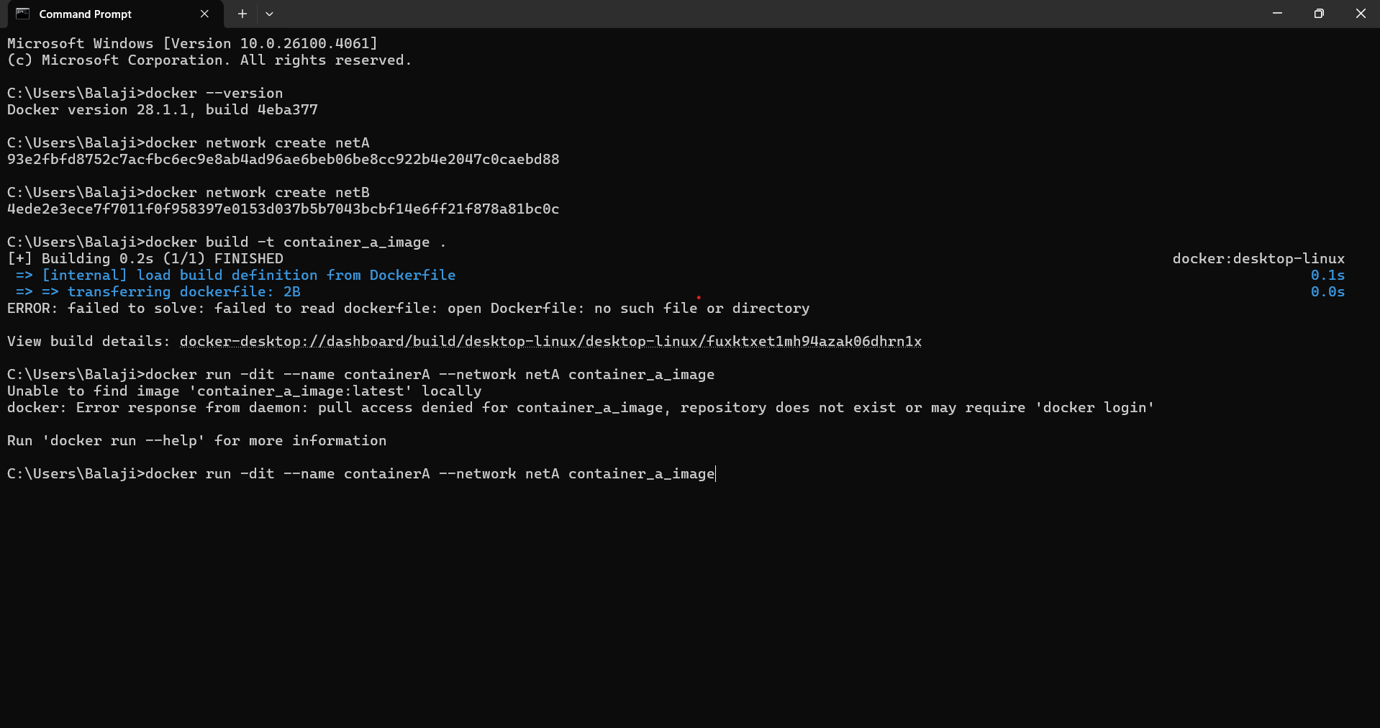
Figure A2.4 – Launching Containers in Isolated Networks

Slide 14
Figure A2.5 – Testing Network Isolation

Slide 15
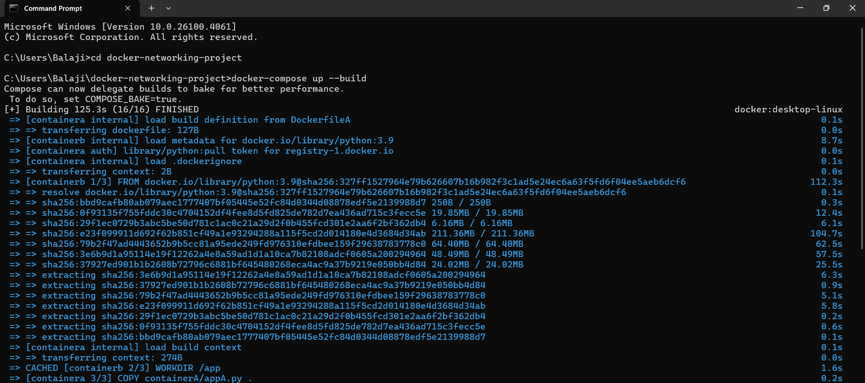
Figure A2.6 – Enabling Controlled Communication

Slide 16
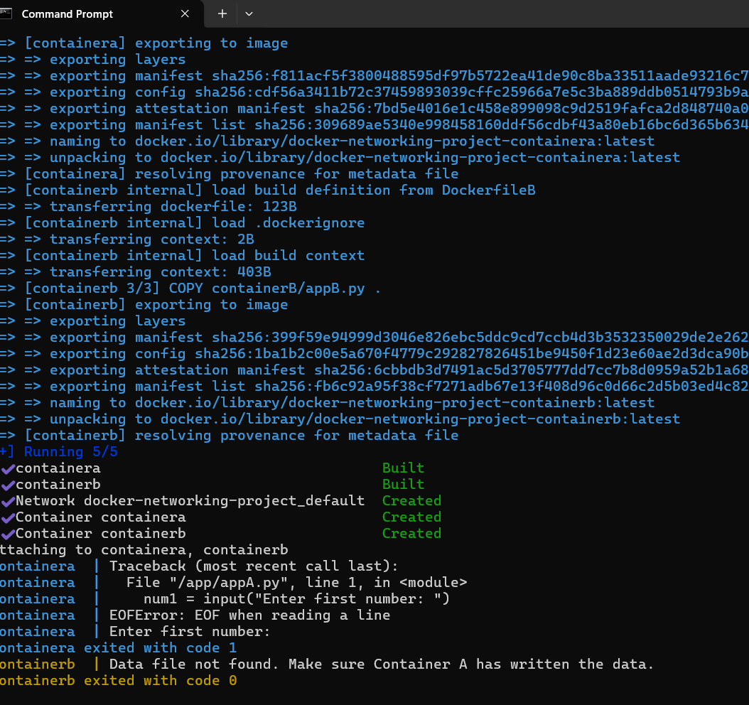
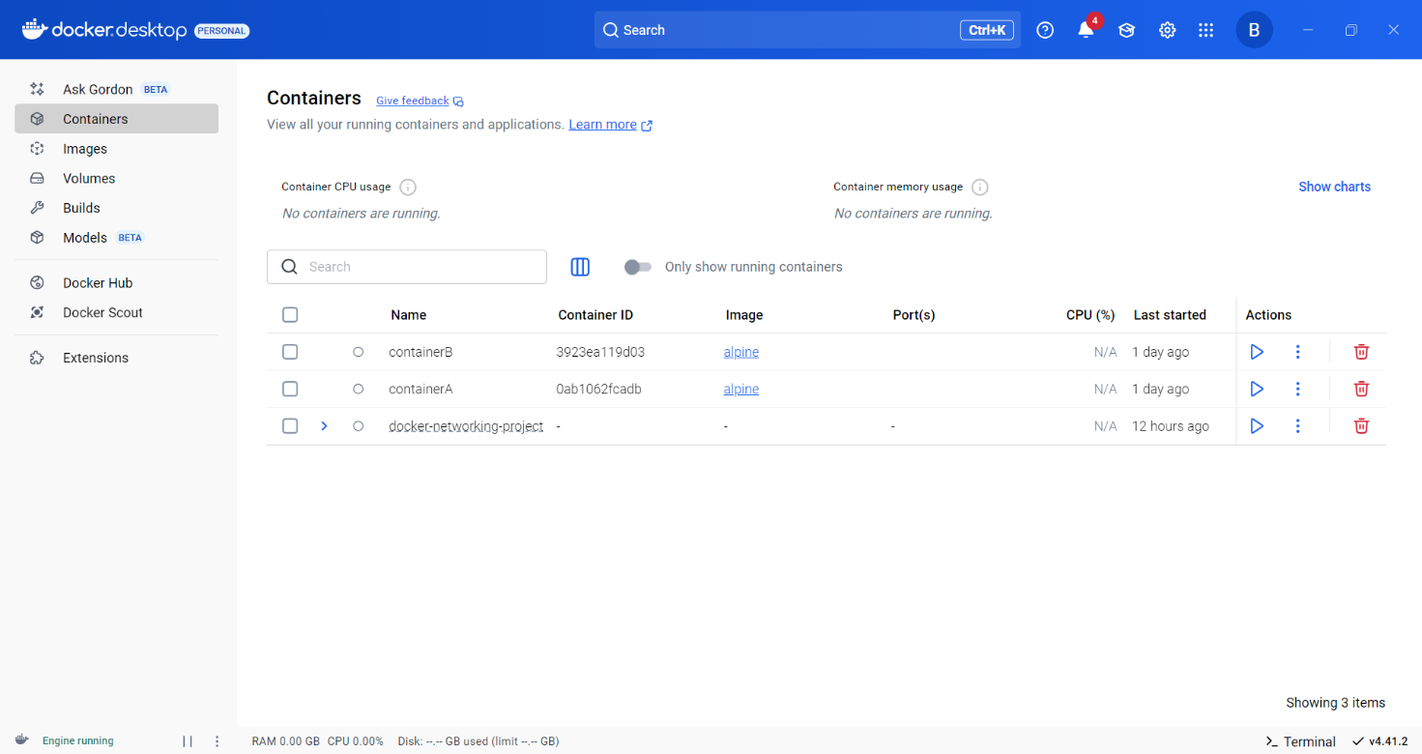

Slide 17
References
https://docs.docker.com/network/
https://docs.docker.com/compose/
Docker Blogs and Tutorials
Project Hands-on Practice

Slide 18
THANK YOU
7

